Slide 1
Population projection on Census data of Italy for the year 2021
Soumita BANDYOPADHYAY

Slide 2
Population Census and Objectives:
A population census is the total process of collecting, compiling, evaluating, analyzing, and publishing demographic, economic, and social data pertaining, at a specified time, to all persons in a country or a well-delimited part of a country.
The main objective of this study is to develop a simple mathematical approach to predict the population of Italy for the year 2021 using past census years (1861-2011) data on population, without attempting any justification of particular assumptions about fertility, mortality, and migration.
Notes:
Insert a map of your country.

Slide 3
Data Description:
We have accumulated the demographic data of Italy from 1861 to 2011 from the site: https://en.wikipedia.org/wiki/Demographics_of_Italy
We also have used the sex ratio of Italy as of 2020 as an approximate estimate of male and female population count for each of the years. The value used is 94.89 from the site: https://knoema.com/atlas/Italy/topics/Demographics/Population/Male-to-female-ratio
Notes:
Insert a picture of one of the geographic features of your country.

Slide 4
Data used:
Year | Total Population | Number of females | Number of males
1861 | 21,777,334 | 11,174,167 | 10,603,167
1871 | 26,801,154 | 13,751,939 | 13,049,215
1881 | 28,459,628 | 14,602,919 | 13,856,709
1901 | 32,475,253 | 16,663,376 | 15,811,877
1911 | 34,671,377 | 17,790,229 | 16,881,148
1921 | 37,973,977 | 19,484,826 | 18,489,151
1931 | 41,176,671 | 21,128,160 | 20,048,511
1936 | 42,993,602 | 22,060,445 | 20,933,157
1951 | 47,515,537 | 24,380,695 | 23,134,842
1961 | 50,623,569 | 25,975,457 | 24,648,112
1971 | 54,136,547 | 27,778,001 | 26,358,546
1981 | 56,556,911 | 29,019,914 | 27,536,997
1991 | 56,778,031 | 29,133,373 | 27,644,658
2001 | 56,995,744 | 29,245,084 | 27,750,660
2011 | 59,433,744 | 30,496,046 | 28,937,698

Slide 5
Methodology:
From our data, we get the following trend diagram (fig1). We find an increasing trend in the graph and it seems that the data follows an exponential trend. So, we keep choosing forecasting models from the lowest order(linear, quadratic, etc.) and fit the model to the data.
Notes:
Insert a picture illustrating a season in your country.

Slide 6
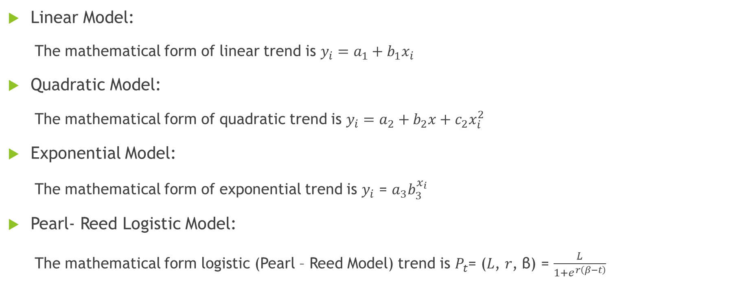
Model Descriptions:
Linear Model:
The mathematical form of linear trend is $y_{i}=a_{1}+b_{1}x_{i}$
Quadratic Model:
The mathematical form of quadratic trend is $y_{i}=a_{2}+b_{2}x+c_{2}x_{i}^{2}$
Exponential Model:
The mathematical form of exponential trend is $y_{i}$ = $a_{3}b_{3}^{x_{i}}$
Pearl- Reed Logistic Model:
The mathematical form logistic (Pearl – Reed Model) trend is $P_{t}$= (𝐿, 𝑟, β) = $\frac{L}{1+ⅇ^{r\left(β−t\right)}}$
Notes:
Insert a picture of an animal and or plant found in your country.

Slide 7
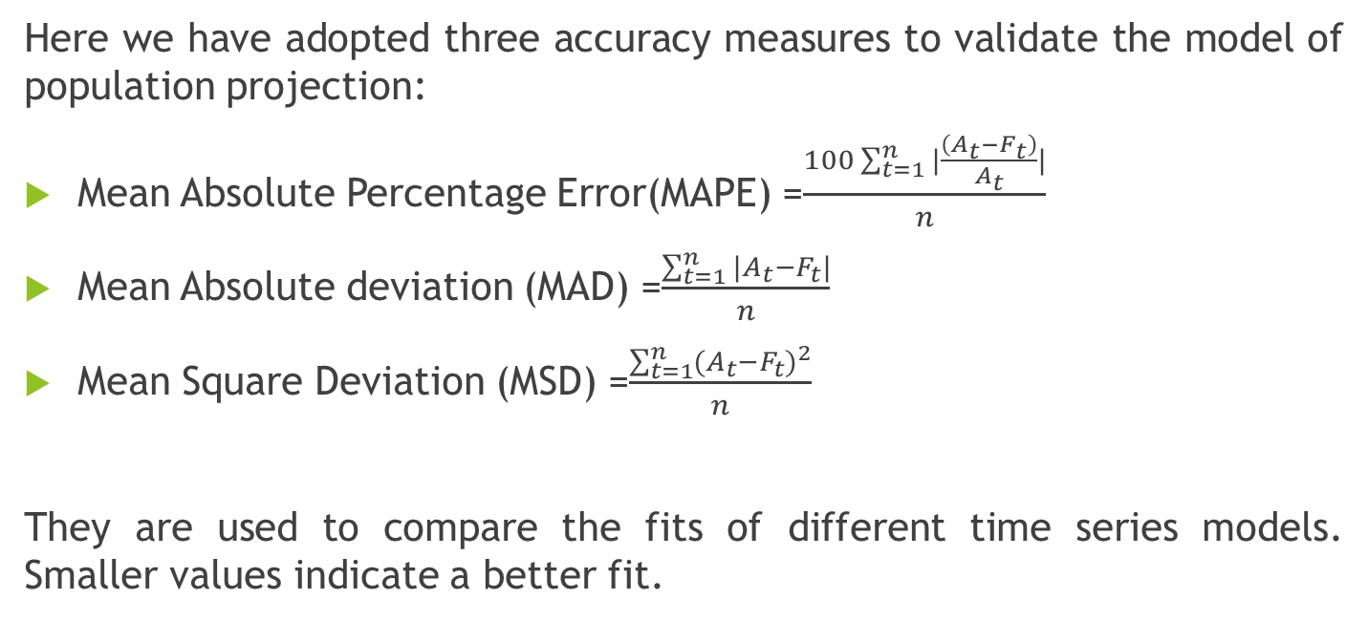
Model Validation:
Here we have adopted three accuracy measures to validate the model of population projection:
Mean Absolute Percentage Error(MAPE) =$\frac{100\sum_{t=1}^{n}{|\frac{\left(A_{t}−F_{t}\right)}{A_{t}}|}}{n}$
Mean Absolute deviation (MAD) =$\frac{\sum_{t=1}^{n}{|A_{t}}−F_{t}|}{n}$
Mean Square Deviation (MSD) =$\frac{{\sum_{t=1}^{n}{(A_{t}}−F_{t})}^{2}}{n}$
They are used to compare the fits of different time series models. Smaller values indicate a better fit.
Notes:
Add key points in the history of your country to the timeline.

Slide 8
Result and Analysis: Model I:
In this method, we will focus on population modeling of Italy and fitting an appropriate model using the past census years (1861-2011) data on population so that we can infer about the future demographic trends of Italy.
We consider the population of 13 census years from 1861-1991, and fit four different mathematical models for model validation using Minitab software.
Next we compare the accuracy measures such as MAPE, MAD, and MSD of four models to find out the best fit for the entire population.
We then fit the best-fitted model obtained by model validation over the 15 observations i.e. from 1861-2011 of the total population to predict the future population of Italy in 2021.
Notes:
Insert a picture illustrating a custom or tradition here.

Slide 9
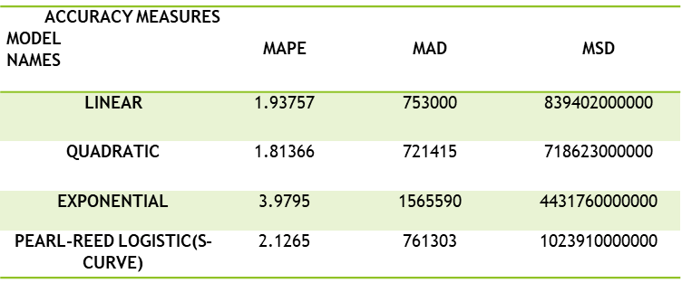
Table 1: Accuracy measures on estimating the population data for years 2001 and 2011 by different models

Slide 10
From the table we see that the Quadratic Model has the least value for all the accuracy measures i.e. MAPE, MAD, and MSD. i.e. the Quadratic Model is the best-fitted (or suitable) model for our dataset.
We fit the Quadratic model over the 15 census years (1861-2011) data of total population to predict the value of total population for any future time points. To get a better projection, we use the data of recent two years i.e. 2001 and 2011 to capture the recent year's trend in the fitted model of the entire population.
So, our estimated population census value for the year 2021 is 61,906,028.
Notes:
Insert a picture of the head leader of your country.

Slide 11
Model II: Projection Of The Male population :
We project the Male Population of Italy separately. We take the data of census years of the male population by omitting the last 2 census years i.e. 2001 and 2011.
Then we will validate four mathematical models to find out the best-fitted model for the male population by comparing three accuracy measures i.e. MAPE, MAD, and MSD.
From table, we see that the Quadratic Model has the least value for all the accuracy measures i.e. MAPE, MAD, and MSD.
Notes:
Insert a picture that illustrates some part of your country’s economy.

Slide 12
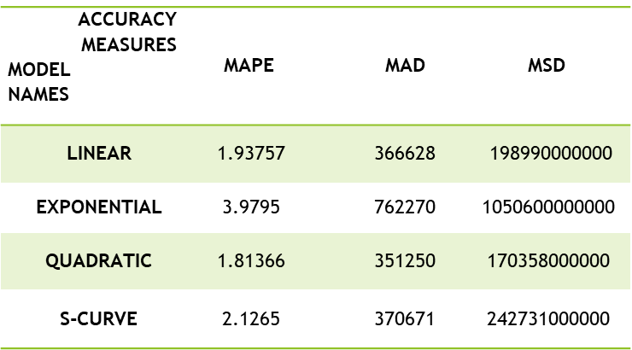
Table 2: Accuracy measures on estimating the male population data for years 2001 and 2011 by different models

Slide 13
We fit the Quadratic model over the 15 census years (1861-2011) data of the male population to predict the value of the male population for any future time points. To get a better projection, we use the data of recent two years i.e. 2001 and 2011 to capture the recent year's trend in the fitted model of the male population.
So, our estimated male population census value for the year 2021 is 3,01,41,429.
Notes:
Insert a picture of one of the points of interest for your country.

Slide 14
Projection Of The Female population :
We project the Female Population of Italy separately. We take the data of census years of the female population by omitting the last 2 census years i.e. 2001 and 2011.
Then we will validate four mathematical models to find out the best-fitted model for the female population by comparing three accuracy measures i.e. MAPE, MAD, and MSD.
From table, we see that the Quadratic Model has the least value for all the accuracy measures i.e. MAPE, MAD, and MSD.

Slide 15
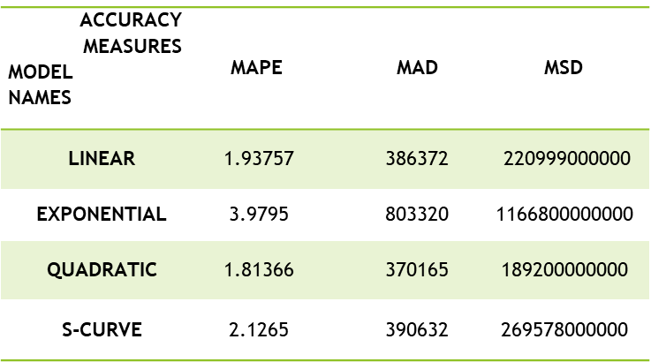
Table 3: Accuracy measures on estimating the female population data for years 2001 and 2011 by different models

Slide 16
We fit the Quadratic model over the 15 census years (1861-2011) data of the female population to predict the value of the female population for any future time points. To get a better projection, we use the data of recent two years i.e. 2001 and 2011 to capture the recent year's trend in the fitted model of the female population.
Estimated female population census value for the year 2021 is 3,17,64,600
Using the predicted values of male and female population for the year 2021, we get the Total census value by adding up those values as:
Estimated population total=Male population+ Female Population =3,01,41,429+3,17,64,600=61,906,029

Slide 17
Conclusion:
From the time series plot (1861-2021), it has been observed that there is a similar kind of sudden downfall of the population between 1871-1891, 1921-1941 and 1981-2001. After 1931, an increasing trend was observed in the population of Italy till 1971.
From our study, we suspect that the population of Italy will increase in 2021, reaching an approximate value of 61,906,029.

Slide 18
THANK YOU

